Slide 1
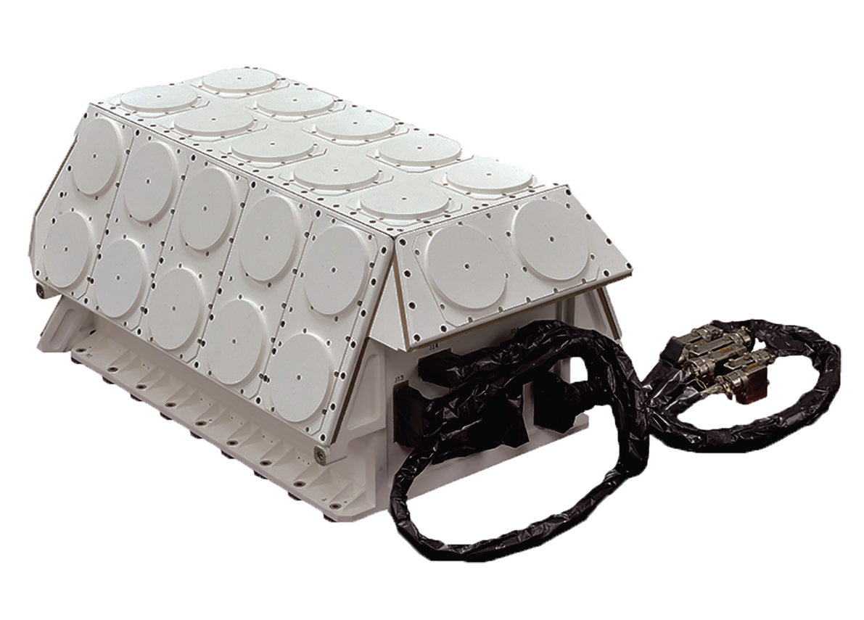
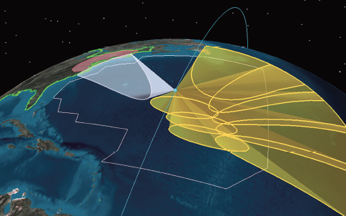
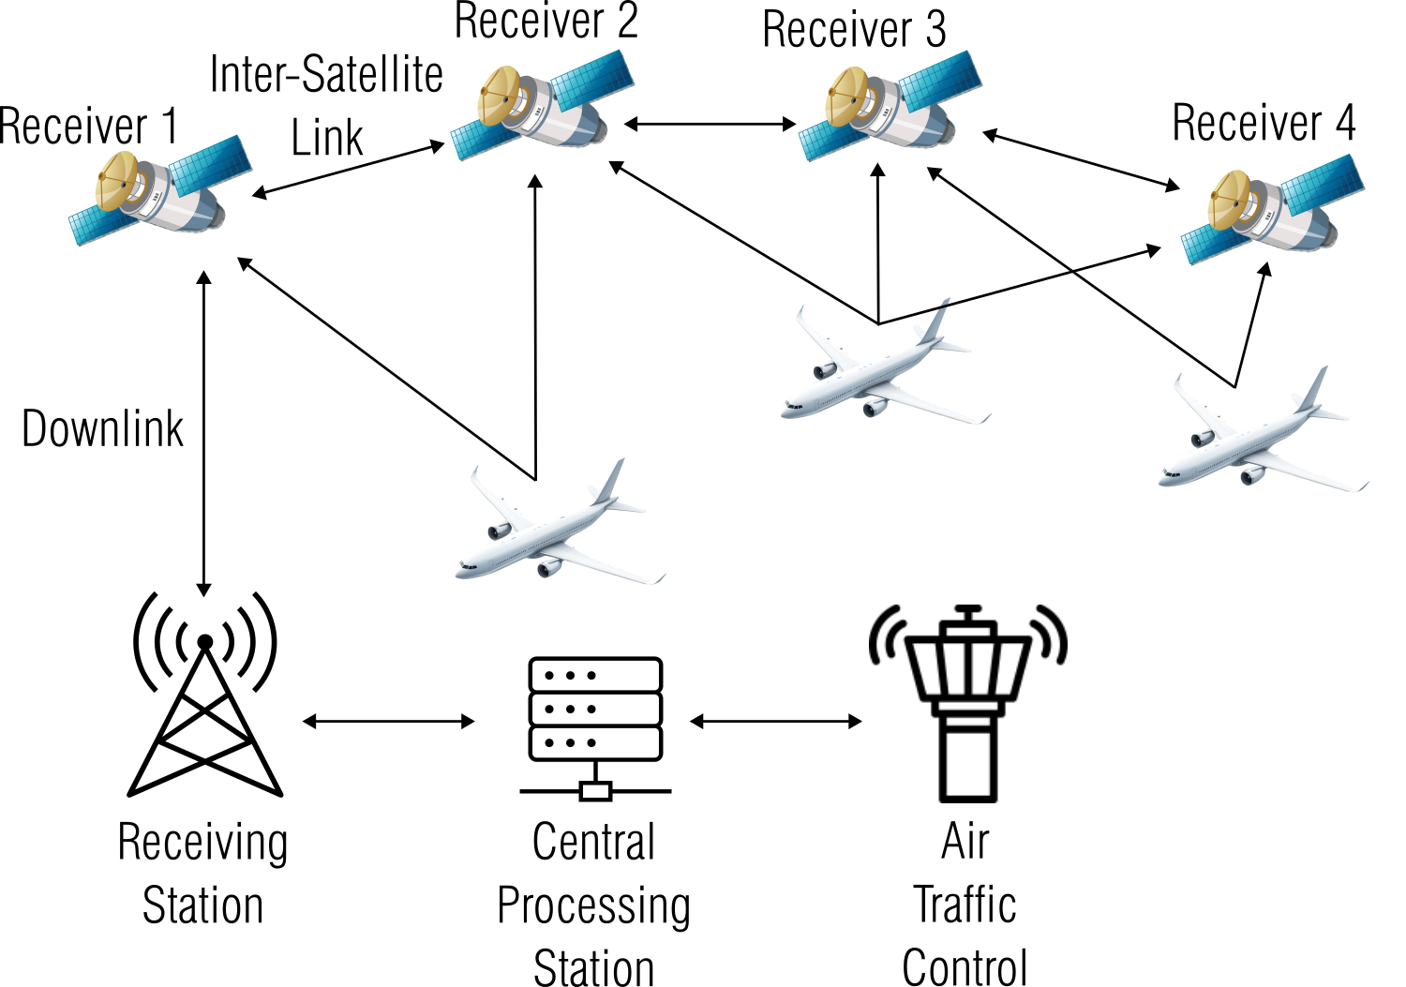
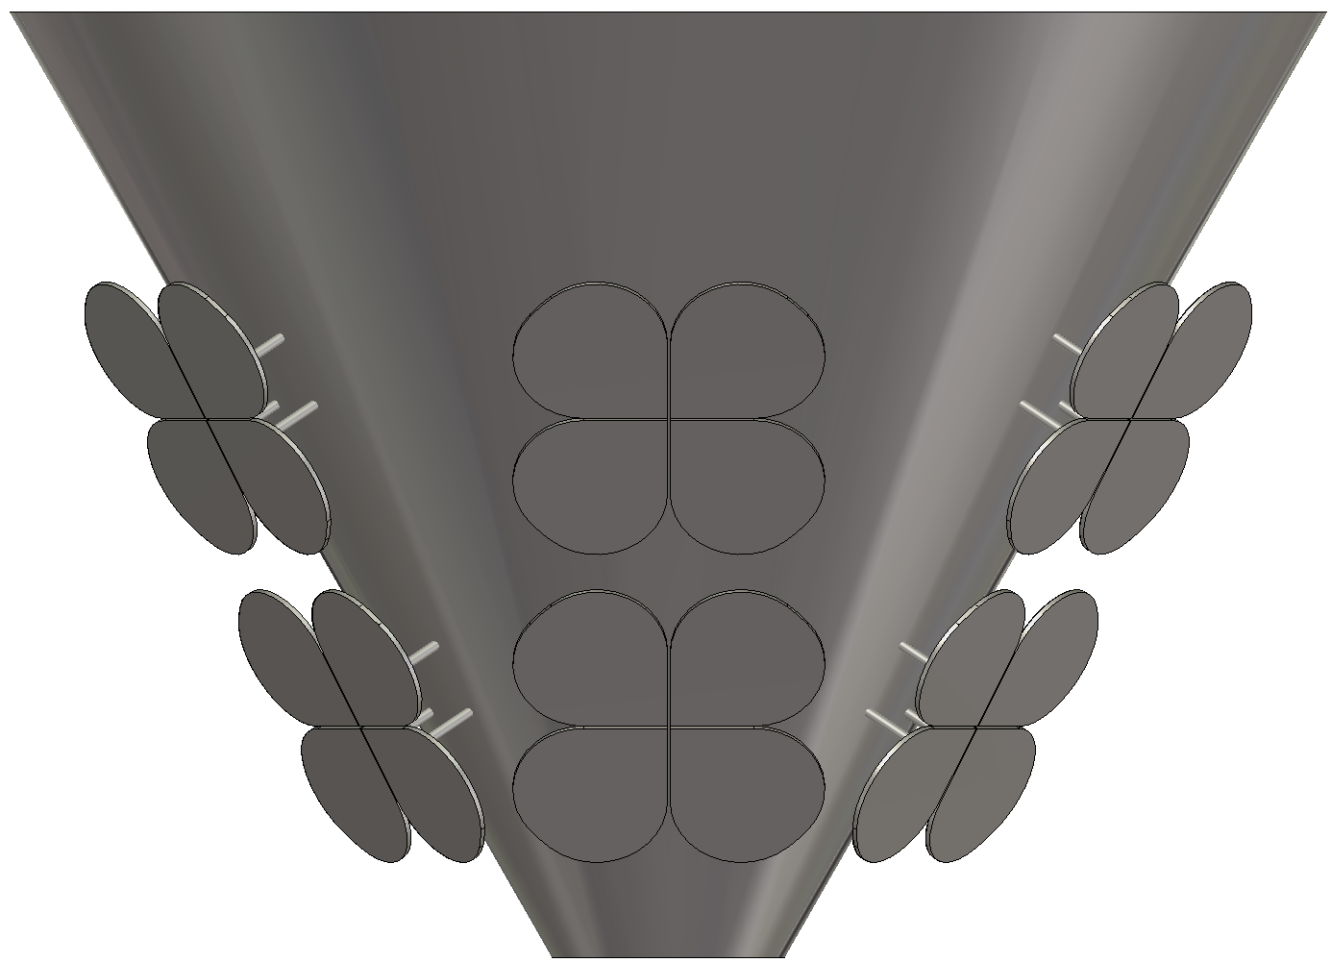
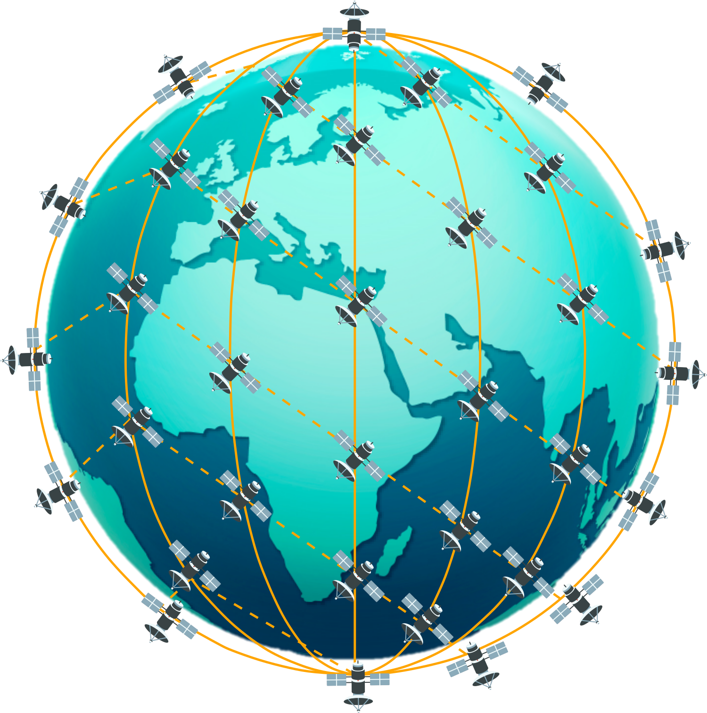
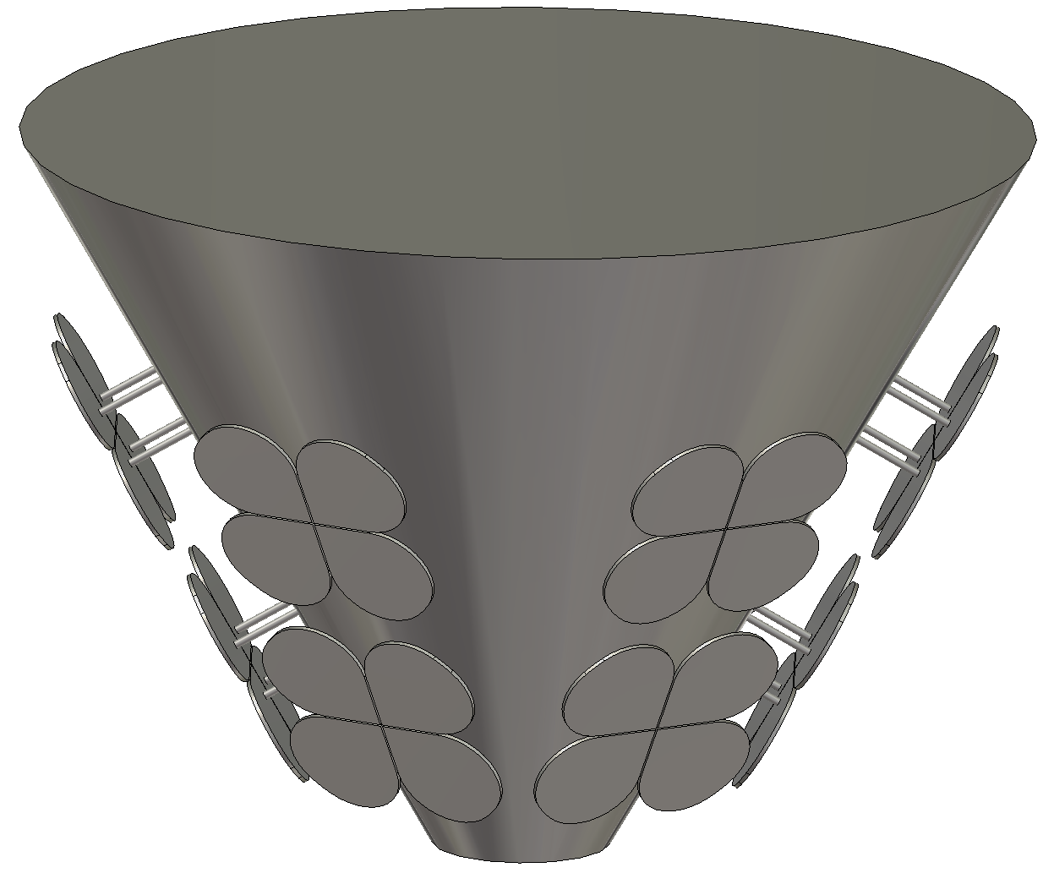
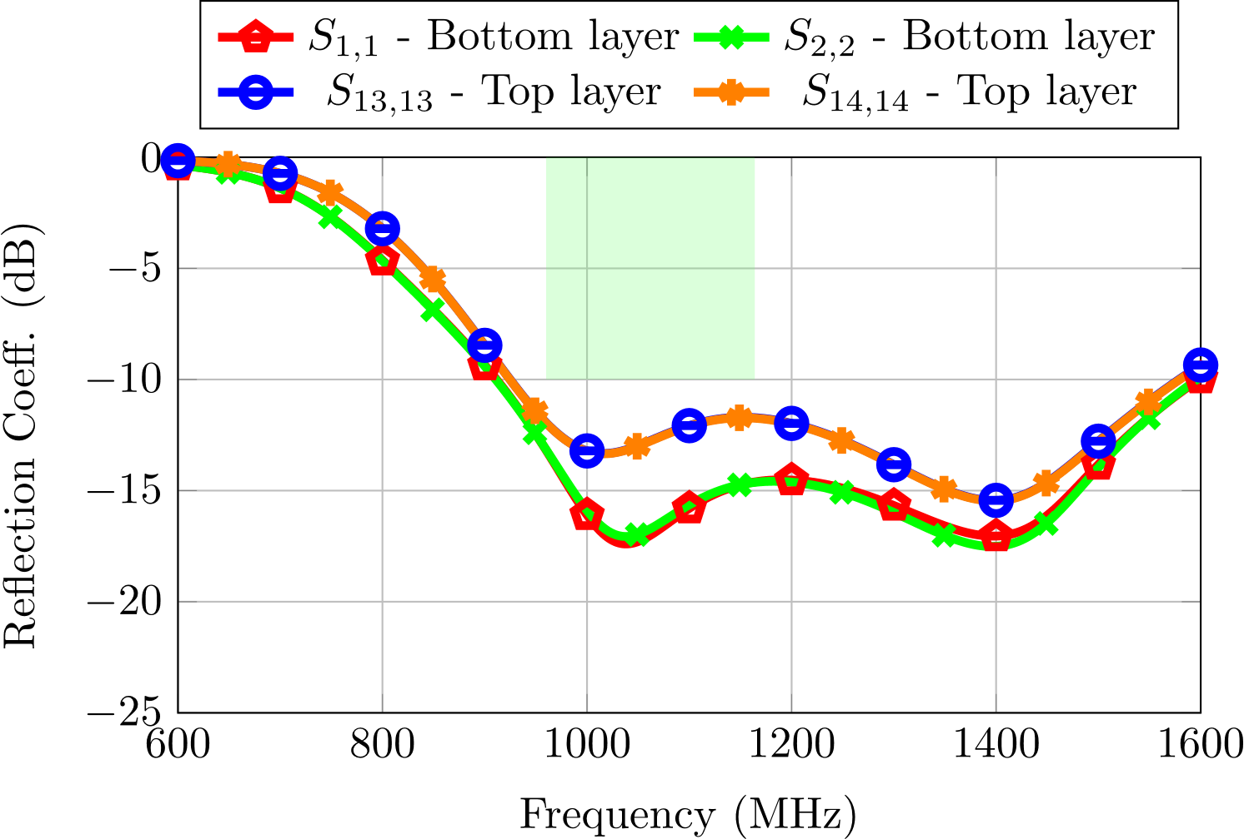
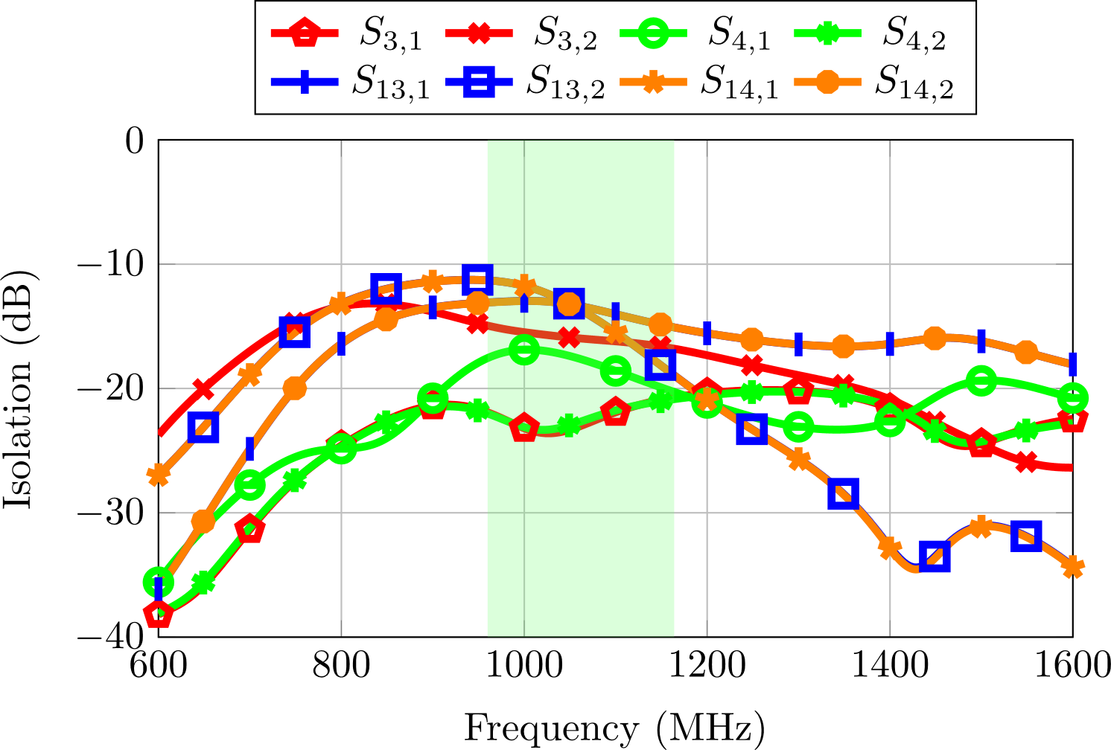
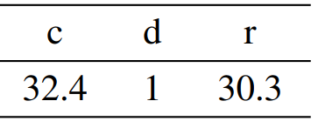
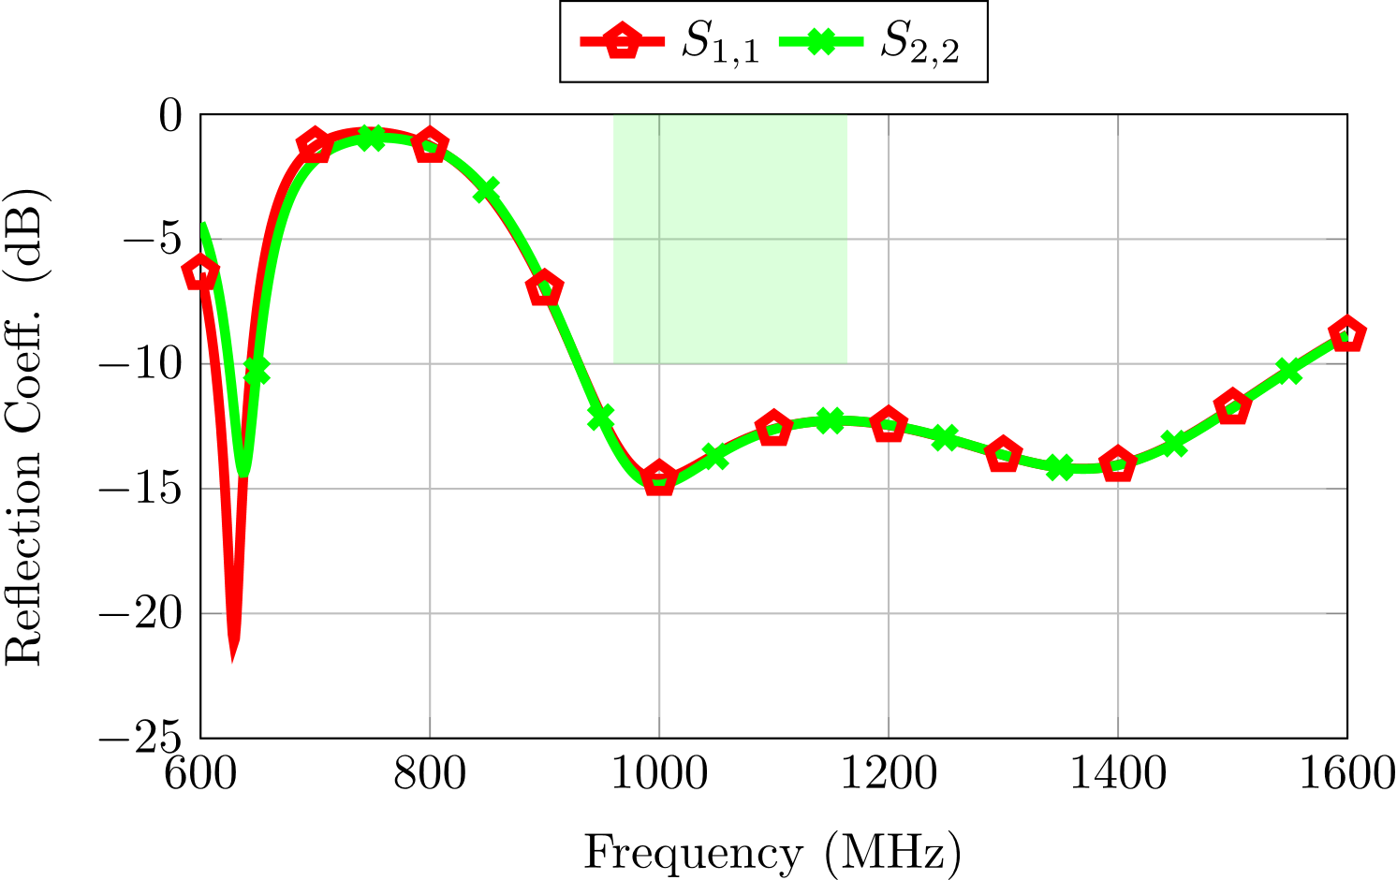
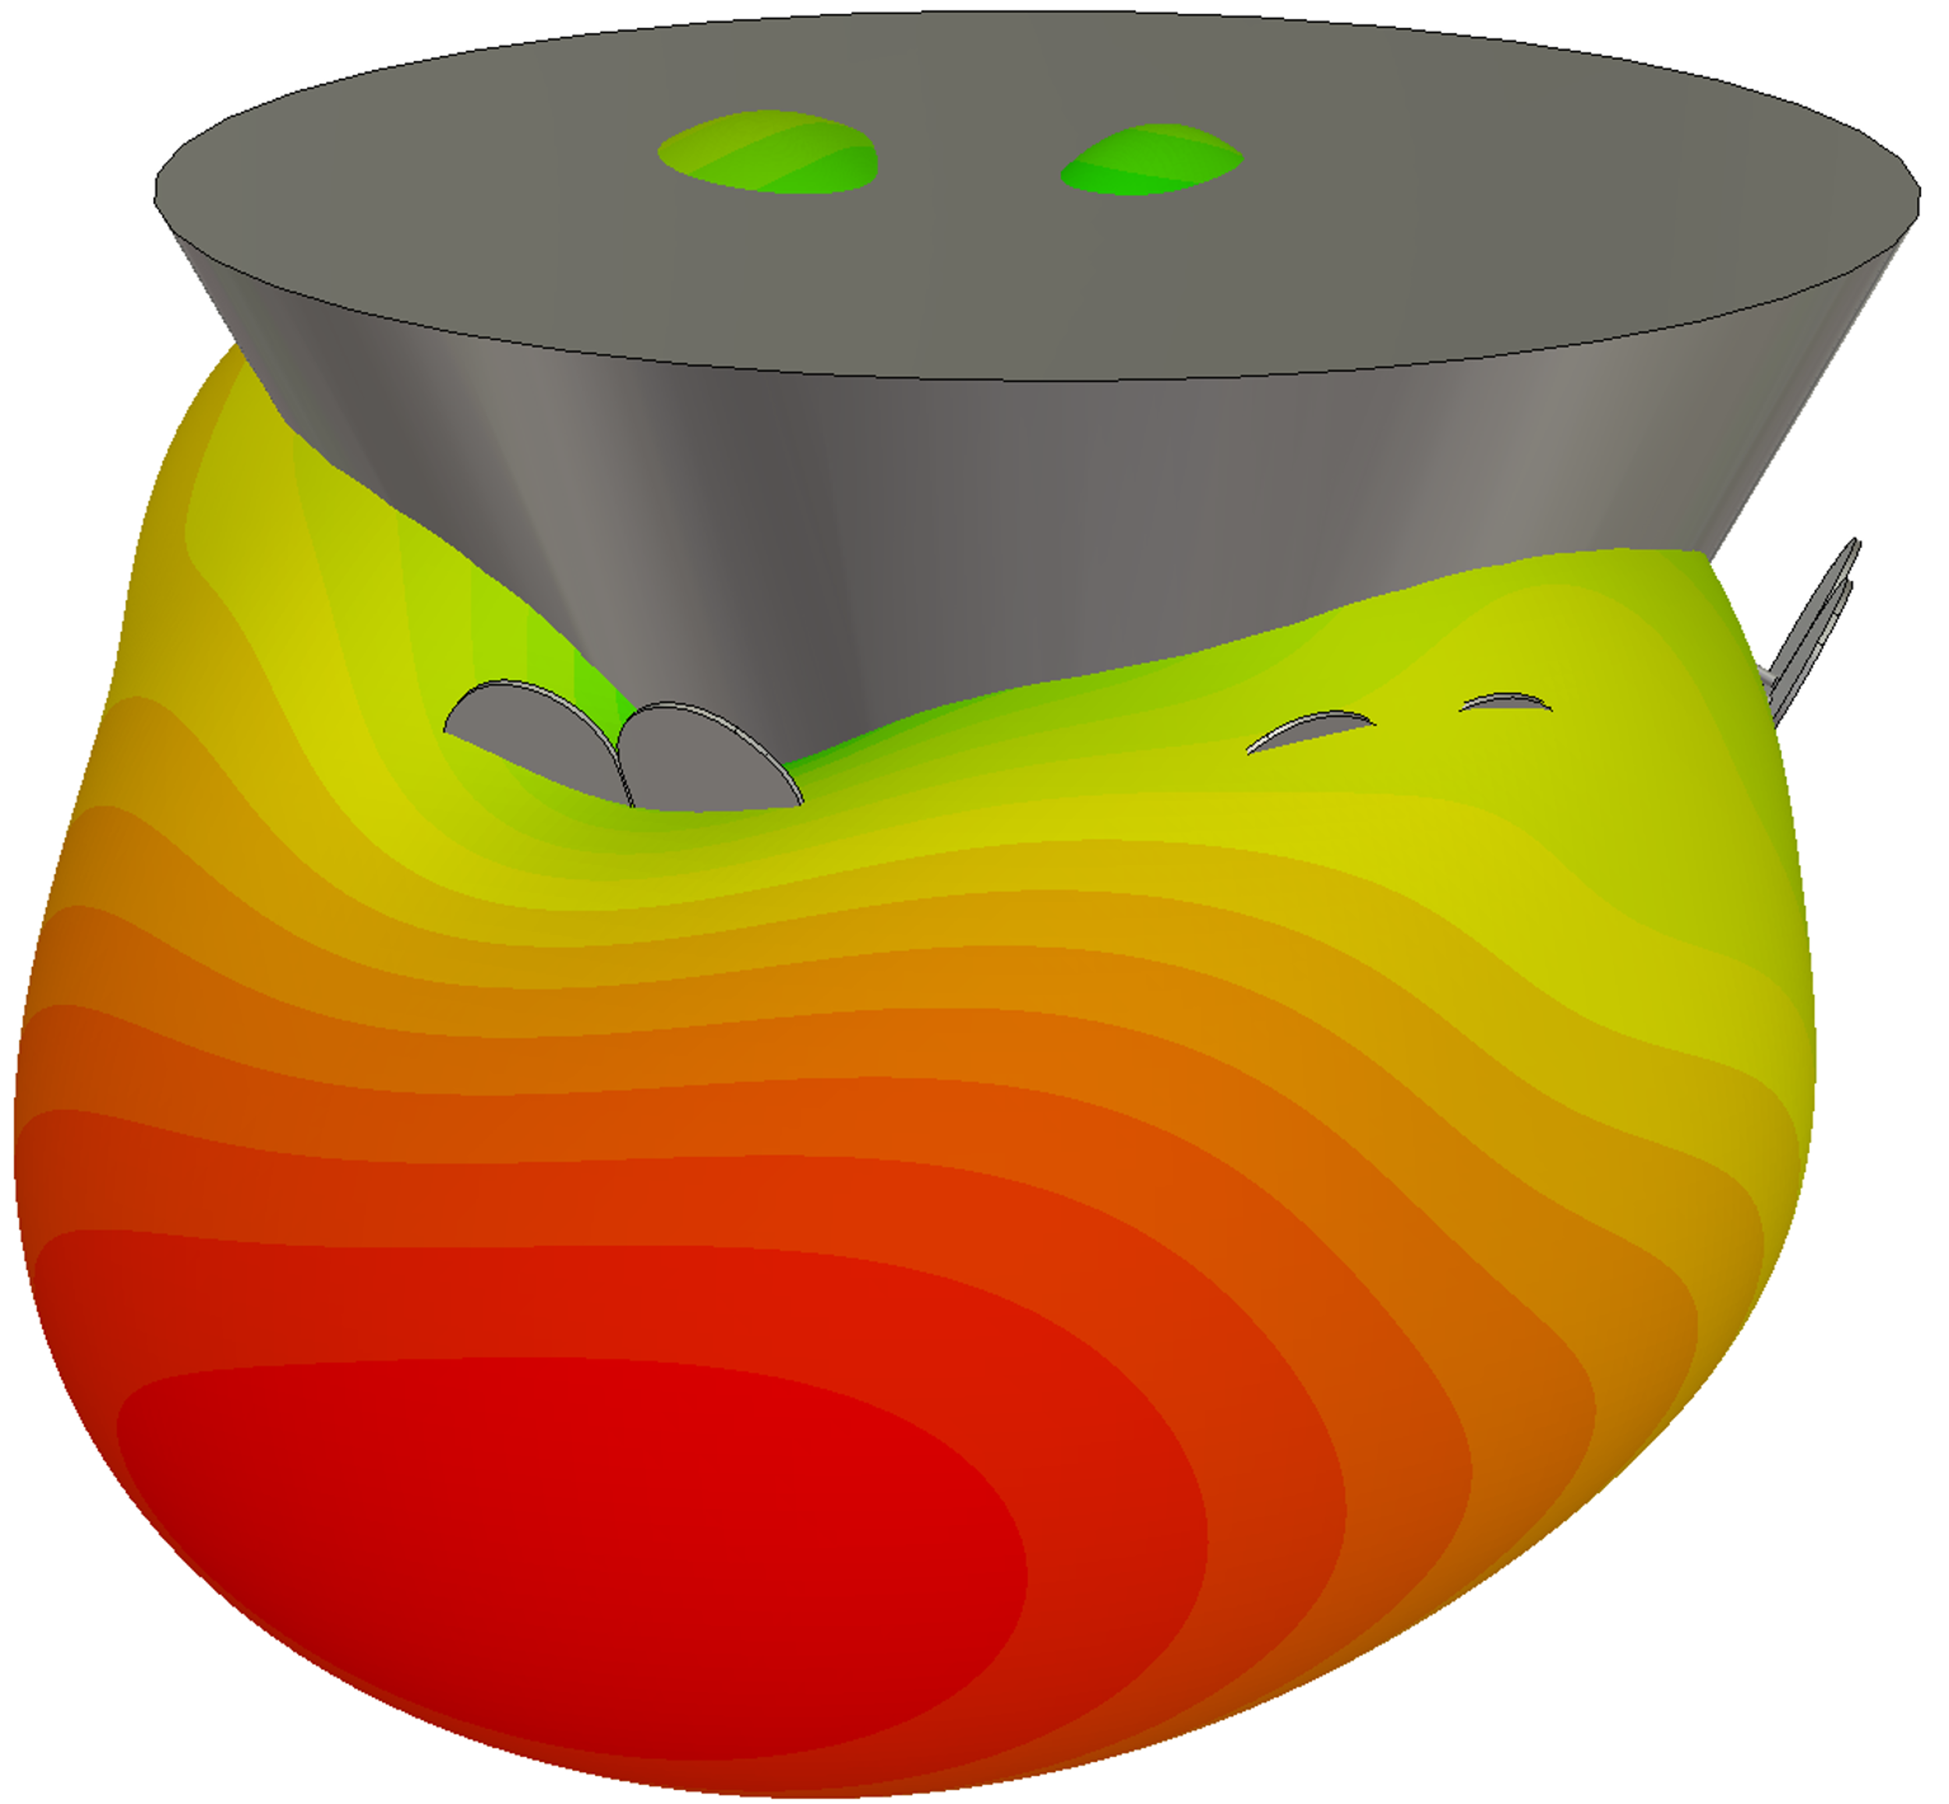
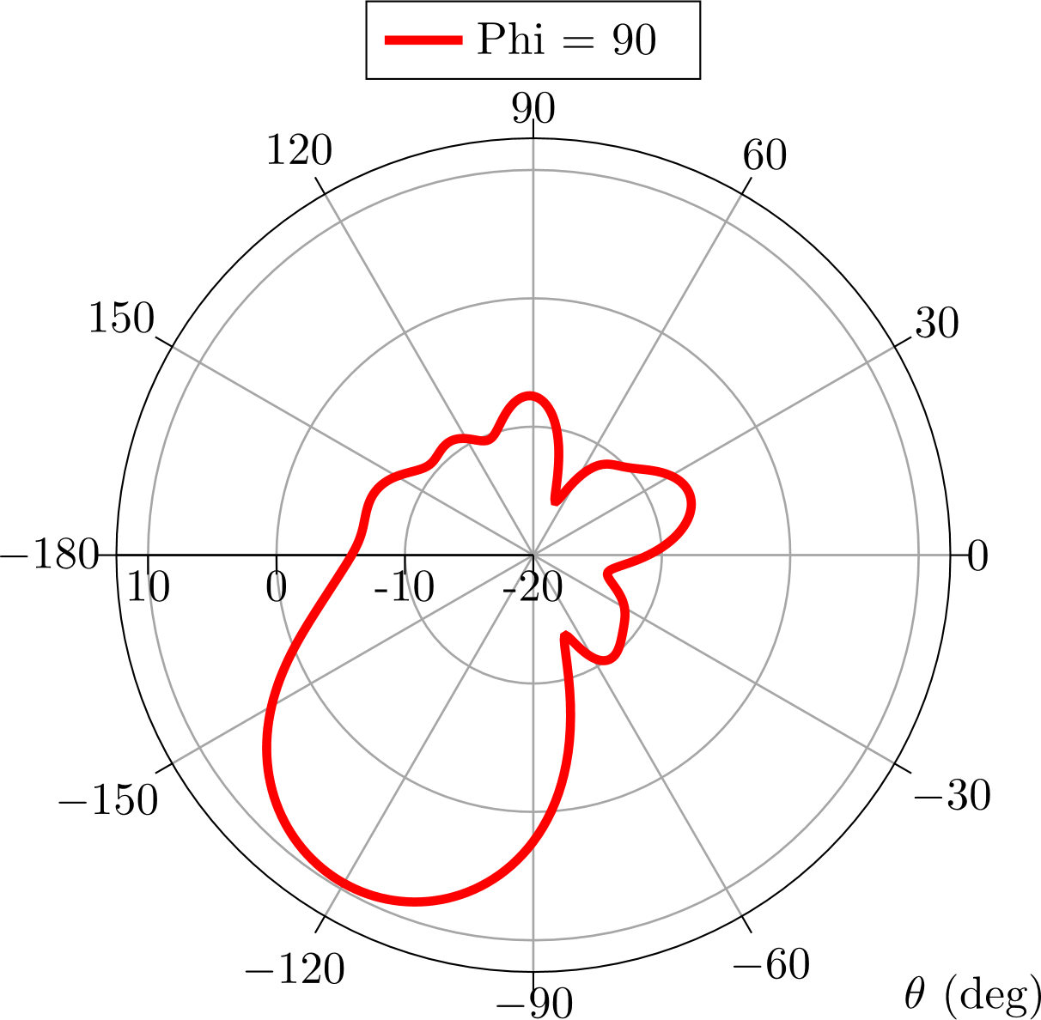
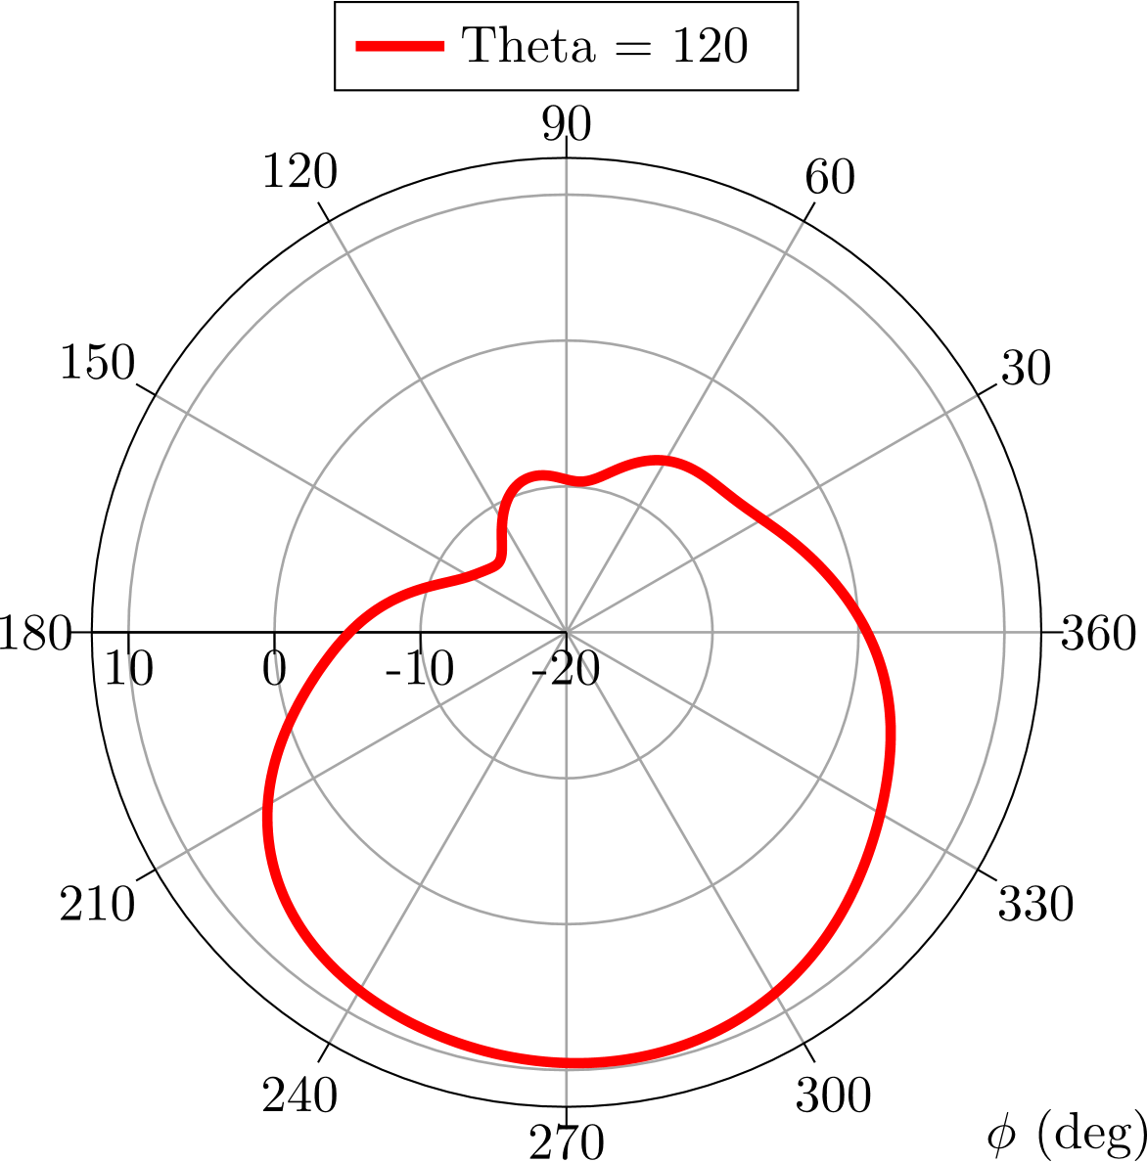
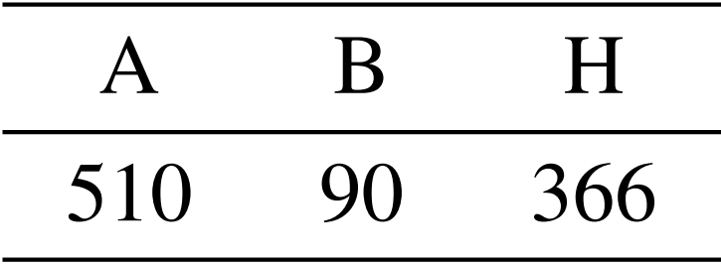
Circularly Polarized Conical Array for ADS-B Applications in LEO Satellites
Javier Vera-Sánchez, Álvaro Martín-Núñez, Miguel Ferrando-Rocher, Miguel Ferrando-Bataller
Antennas & Propagation Lab (APL), iTEAM Research Institute
Universitat Politècnica de València, c/ Cami de Vera s/n, 46022, Valencia, Spain, jversan2@upv.es
ABSTRACT
This paper presents the design of a dual-layer conical antenna array tailored for Automatic Dependent Surveillance-Broadcast (ADS-B) applications intended for integration into Low Earth Orbit (LEO) satellites. The proposed antenna system comprises two vertically stacked layers, each comprising six magneto-electric dipole antennas arranged in a circular configuration. Each antenna element covers a sector of ±30º in azimuth, providing comprehensive coverage for real-time aircraft tracking over wide geographical regions. The array operates within the L-band spectrum (960–1164 MHz), making it suitable for ADS-B communication in remote areas with limited ground station coverage, such as oceans and deserts.
AUTOMATIC DEPENDENT SURVEILLANCE-BROADCAST (ADS-B) SYSTEMS
AIREON Hosted Payload
ADS-B operational requisites
Antenna design constraints
ADS-B signals tx in L-band: 960 – 1164 MHz
Center frequency of 1090 MHz
Limited volume onboard the satellite (1m x 0.5m)
Notional View of Spot beams
Over the Earth's surface
ADS-B communication performance
Signals transmitted @ 1 Mbps
Pulse Position Modulation (PPM)
Combination of ToA, FoA and AoA to detect aircrafts
Mode S (Select) interrogations to aircrafts
AIREON Hosted Payload on the IRIDIUM Next Space Vehicle
SATERA PROJECT AND CONSTELLATION
Satellite-based ADS-B architecture
Constellation proposal
Walker-Star Constellation
All-metal conical array
700 km height
86º inclination
10 orbits
20 satellites per orbit
High-efficiency circularly-polarized magneto-electric dipole array for ADS-B L-band radiolinks with aircrafts.
Can also be used for LDACS applications.
Full 360-degree azimuth coverage.
Array easily reconfigurable.
Very simple coaxial feeding.
60-degree inclination to maximize Earth coverage.
Space-based composite Ads-b and multilaTeration systEm validation thRough scalable simulAtions
CONE-SHAPED ARRAY
Unit–cell antenna
6x2 cone-shaped array
Dimensions of unit cell antenna in mm
Adaptation @ 1090 MHz = -12.2 dB
Coupling @ 1090 MHz = -13.8 dB
ADS-B operational band covered
Coupling mostly below -15 dB across ADS-B operational band covered
A. Martín-Nuñez, et al., “Design of a Cone-Shaped Array for Aeronautical Applications in LEO Satellites,” in 2024 IEEE International Symposium on Antennas and Propagation and INC/USNC-URSI Radio Science Meeting (AP-S/INCUSNC-URSI). IEEE, 2024, pp. 2359–2360.
Pattern of 1 sector (60º) – 2x1 array
Bandwidth = 650 MHz
Directivity = 9.56 dBi
Dimensions of cone array in mm
Directivity = 9.32 dBi
Adaptation @ 1090 MHz = -16.6 dB
Radiation efficiency = 92%
Radiation efficiency = 95%
Bandwidth = 700 MHz
19th European Conference on Antennas and Propagation
Stockholm, Sweden, March 2025
This work is part of the SATERA project and received funding from SESAR 3 Joint Undertaking (JU) under grant agreement 101164313, as well as from Ministerio de Ciencia e Innovación under research project PID2022-136869NB-C33.

